Slide 1
Community Organizing

Slide 2
Agenda
Welcome
Developing a Shared Solution
Creating an Action Plan
Defining Target Communities
Building Relationships and Goal Setting
Close/Case Study

Slide 3
Learning Objectives
At the completion of this presentation, participants will be able to….
create a shared outreach solution.
create an action plan.
define a target audience.

Slide 4
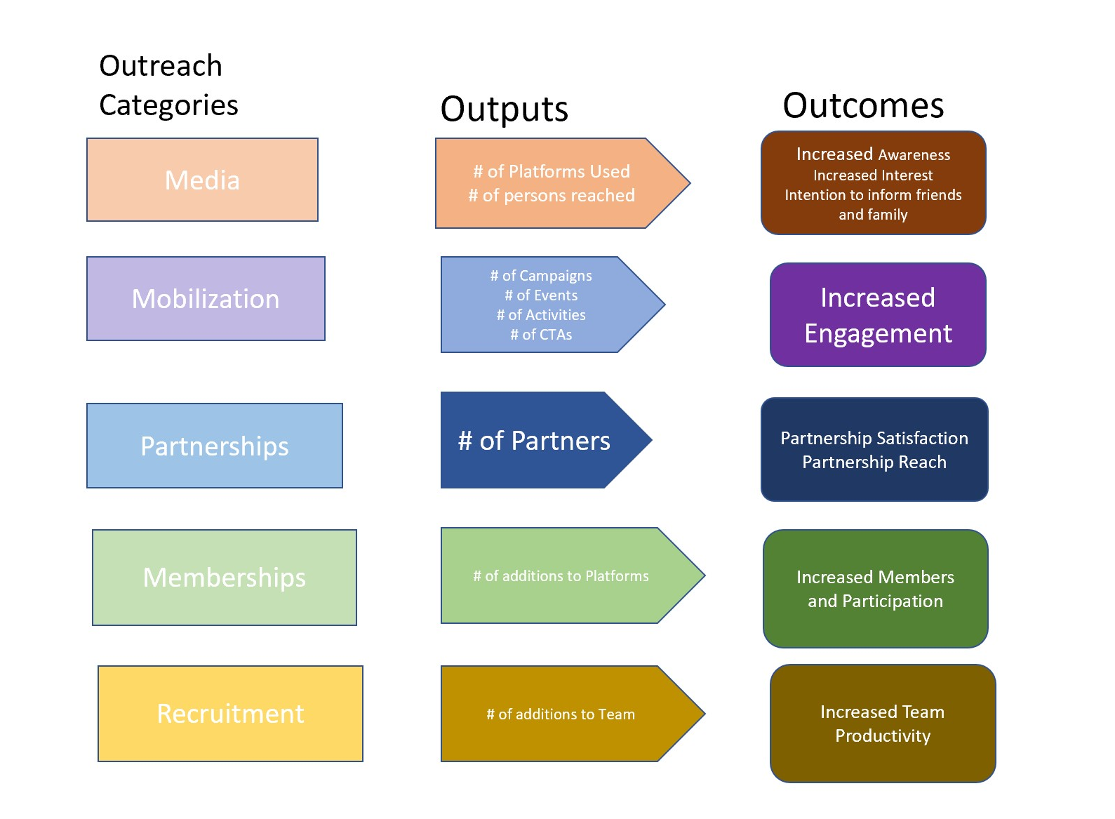
Outreach Strategy
Provide any other Categories, Outputs, Outcomes
Speaking Engagements and Panel Discussions
Outreach Category add Outreach Team Recruitment
Increase Volunteer Engagement-Outputs

Slide 5
Letters of Support Process
Receive Letter of Support from Social Media Team
Receive Emails
Copy/Paste Document and Send
Inform Your Followers
Ask Your Followers to Perform the Same Process

Slide 6
Target Audiences Blue Collar Churches Families Academics Youth-HBCUs Youth-Colleges Youth-High School Young Professionals Retired

Slide 7
Call To Action
Internal Subscriptions
You Tube
Twitter
Instagram
FB
External Subscriptions
Other Platforms
Email Campaigns
Op Ed Article
Video Your Story
Clubhouse Promoting

Slide 8
Smart Goal Setting
Mission/Vision
Theory of Change
Smart Goals

Slide 10
Case Study

Slide 11
Theory of Change
Strategies
Community Engagement
Building Social Networks
Outcomes
Increased emphasis on Green Street Projects
Vision
To reduce environmental impacts by building awareness related to redlining’s impact on climate change and access to green, open, and clean spaces.
Data and Information
Increased Cultural Education and Community Awareness
Increased emphasis on Community Land Trust Governance

Slide 12
Conclusion and Questions

